Slide 1
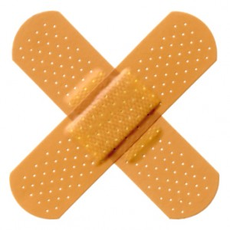
Cancer
Lesson 5.4
What happens once cancer has been treated?

Slide 2
Do Now
Do cancer treatments eliminate all trace of disease? Why or why not?
Why do some tumors disappear forever and some tumors come back?

Slide 3
What happens after treatment?
Remission – the disappearance of all symptoms related to cancer.
Recurrence – the reappearance of symptoms caused by the original cancer or the spread of cancer to other organs.

Slide 4
The tumor after radiation treatment

Slide 5
The tumor has now had a course of targeted chemotherapy

Slide 6
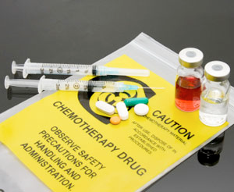
Mutants that survive initial treatment may need different chemotherapy

Slide 7
Activity
Your patient ten years on…..
What was the outcome?
How did the treatment affect the outcome?
If you knew then what you know now, would you have done anything differently?

Slide 8
When conventional treatment fails
Palliative Therapy
Alternative /Complementary therapy
Hospice care

Slide 9
Different ways to manage cancer symptoms
Palliative Therapy
Alternative /Complementary therapy
Hospice care

Slide 10
Palliative therapy
Given by medical team to provide relief of physical symptoms particularly pain.
Is part of standard cancer treatment protocols
Begins at diagnosis and continues throughout illness

Slide 11
Palliative therapy may use alternative approaches
If you’re experiencing | Consider trying
Pain | Acupuncture, aromatherapy, hypnosis, massage, music therapy.
Fatigue
Nausea and vomiting
Sleep problems
Anxiety
Stress
From Mayo Clinic

Slide 12
Palliative therapy may use complementary approaches
If you’re experiencing | Consider trying
Pain | Acupuncture, aromatherapy, hypnosis, massage, music therapy.
Fatigue | Exercise, massage, relaxation techniques, yoga
Nausea and vomiting | Acupuncture, aromatherapy, hypnosis, music therapy
Sleep problems | Exercise, relaxation techniques, yoga
Anxiety | Hypnosis, massage, meditation, relaxation techniques
Stress | Aromatherapy, exercise, hypnosis, massage, meditation, Tai chi, yoga
From Mayo Clinic

Slide 13
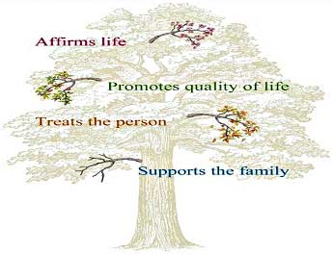
Non-physical symptoms
Psychological
Practical
Spiritual
Palliative therapy may use both conventional and alternative approaches.

Slide 14
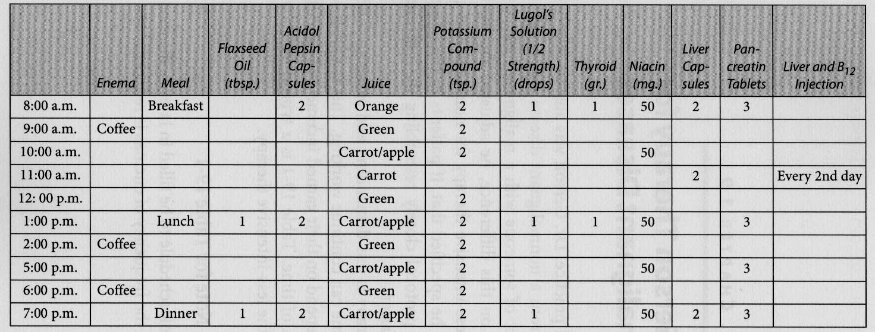
Diet and cancer
There has been no case-controlled study to show the Gerson method is an effective treatment for cancer.

Slide 15
Hospice care
Palliative care at the end of life
Transition from ‘curing to caring’
May involve significant pain management
American Cancer Society.

Slide 16
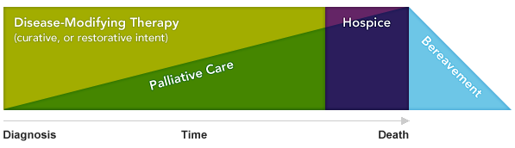
Wrap up: An Integrated Treatment Model
As the disease worsens, more emphasis is spent on palliative and hospice care.
After death, support for families is essential (bereavement care).

Slide 17
Wrap Up: Can we avoid cancer?
Be aware of our genetic heritage
Minimize the incidence of mutations
Bolster our immune systems

Slide 18
Homework
Watch the video about the cost of end of life care.

